Slide 1
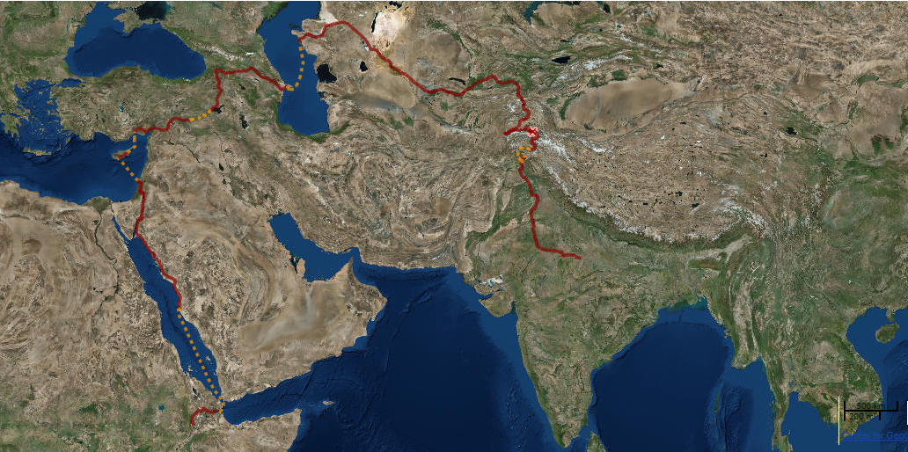
Creating Maps – and The Out of Eden Walk
A presentation and mapping activity for the
Dhirubhai Ambani International School
by Jeff Blossom of the Center for Geographic Analysis, Harvard University

Slide 2
Me - Jeff Blossom
Harvard University, Cambridge, Massachusetts
My building My office
Work at the Harvard Center for Geographic Analysis in Cambridge, Massachusetts, helping professors and students map stuff and analyze geographic data.
Geographer
Geographic Information Specialist
Cartographer

Slide 3
Cartography
The creation, production, and study of maps.

Slide 4
Paul Salopek,
journalist
Notes:
Jeff and Paul’s “The Greatest Walk” map

Slide 7
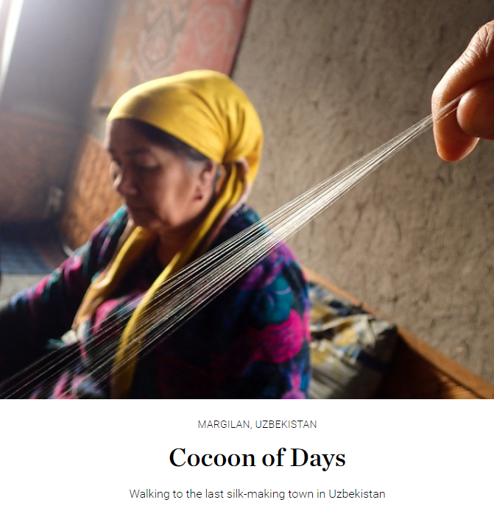
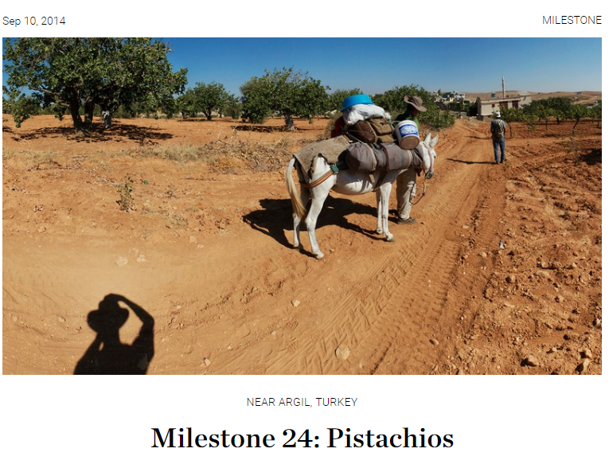

Slide 8
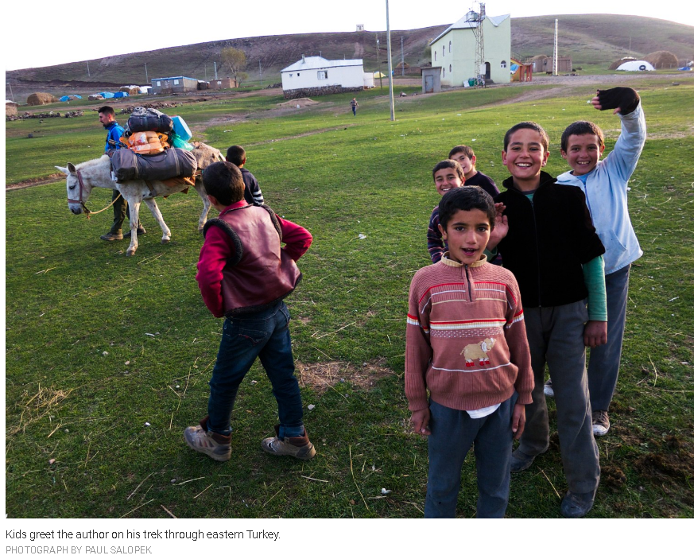

Slide 9
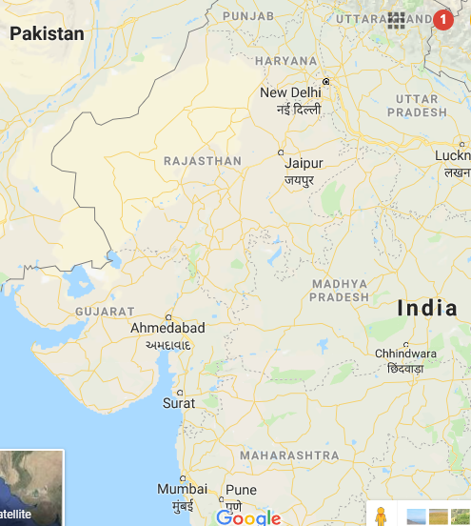
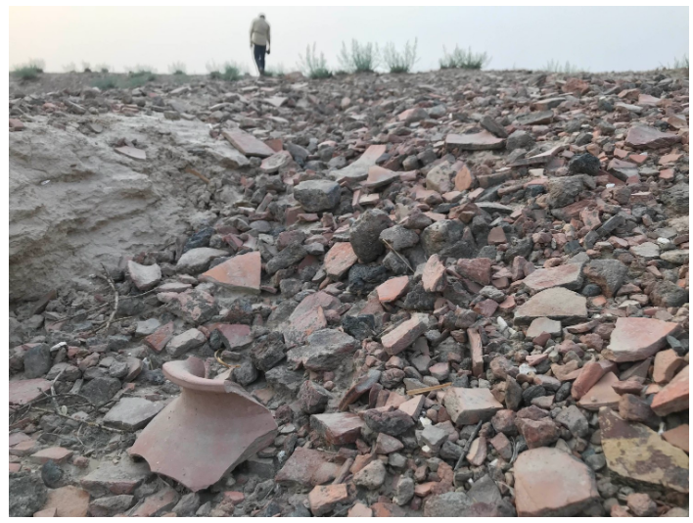
Kalibangan, Rajasthan

Slide 10
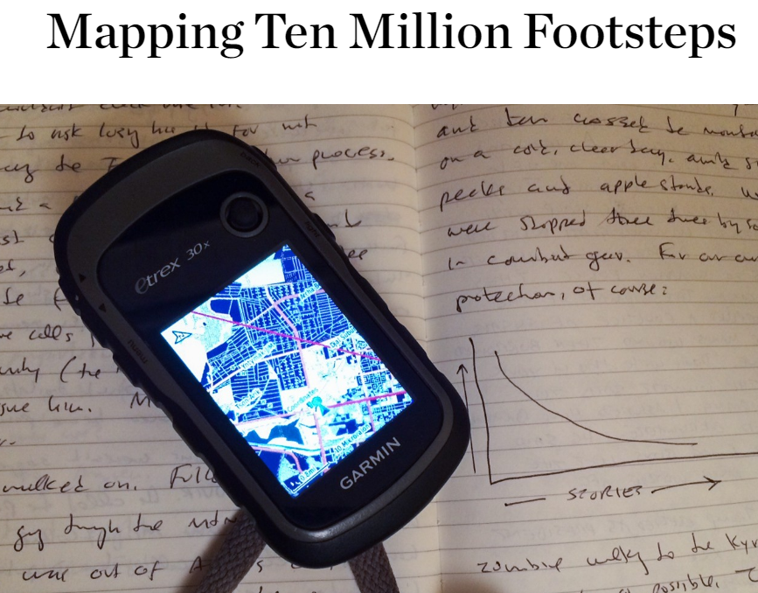
Paul’s notebook and Global Positioning System (GPS) mapping device.

Slide 11
GPS receivers use signals from satellites to calculate location.
90
45
0
-180
-90
0
90
180
-45
-90
Longitude, latitude coordinates in decimal degree format
Notes:
From CGA training materials

Slide 12
Latitude:
An angular distance north or south of the Equator measured from the center of the Earth.
Notes:
From Geosystems (Fourth Edition), Robert W. Chirstopherson. Chapter 1

Slide 13
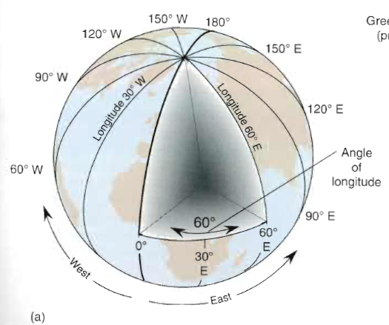
Longitude:
An angular distance east or west of a point on the Earth’s surface, measured from the center of the Earth.
Notes:
From Geosystems (Fourth Edition), Robert W. Chirstopherson. Chapter 1

Slide 14
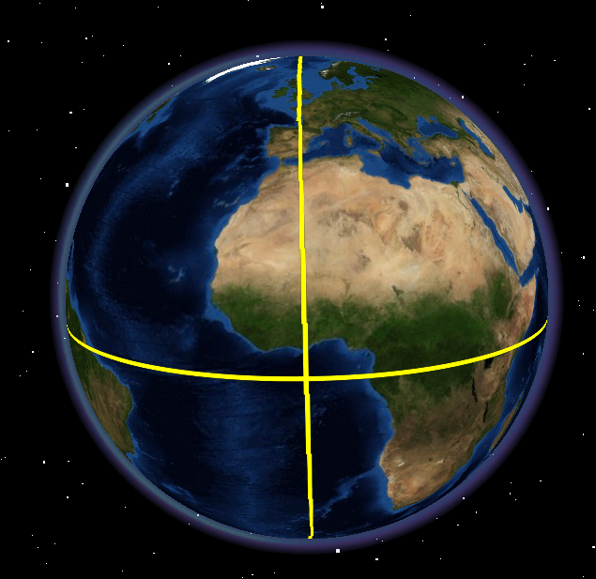
Geographic Coordinate System – a common reference used to map things on Earth.
Use lines of longitude and latitude.
Any location on Earth can be represented by the intersection of a longitude, latitude line.
19.0665, 72.871 is the latitude, longitude of Dhirubhai Ambani
School!

Slide 15
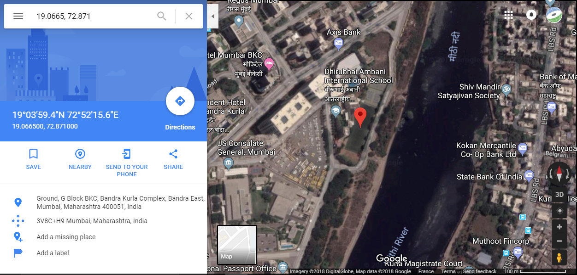

Slide 16
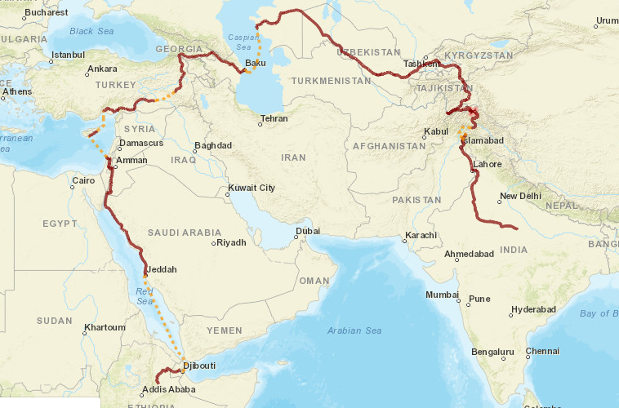
Paul’s current location:
On the banks
of the Ganges, approaching
Varanasi.
Notes:
http://worldmap.harvard.edu/maps/completed_route

Slide 17
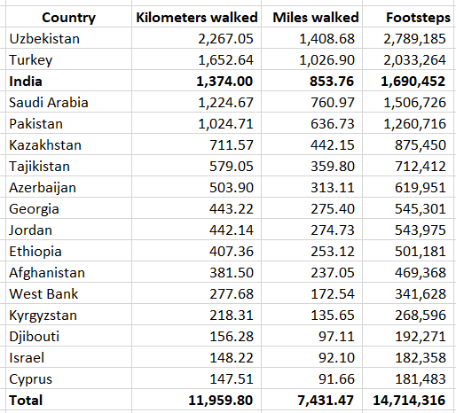
Still counting!
India

Slide 18
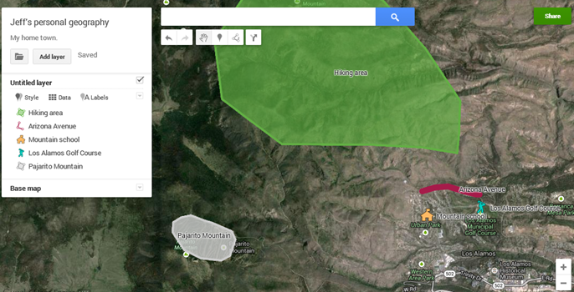
Goal for today: For everyone to make a map! We will use points, lines, and polygons

Slide 19
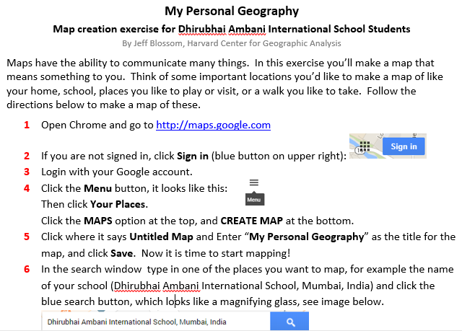
The mapping exercise:
Notes:
https://drive.google.com/open?id=0B7nei6otw0JPYTAtaERfRUxUUkU

Slide 20
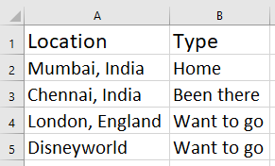
Summary - a few ways to make maps
Using Global Positioning Systems (GPS)
A Google search in a My Map
Sketching from an existing map
Using tables of information (see next slide for how to do this)

Slide 21
Map a list of locations with BatchGeo
On the web, go to: drive.google.com
Click NEW > Google Sheets
Create a list of places you’ve been, and also want to go, like this:
Highlight the rows in the list, and click Edit > Copy
Open a new tab in your web browser, and go to batchgeo.com
Right click and choose Paste into the box at the top
Click the Map Now button. Enter your email and the map will be sent to you.
Now your information is mapped! Explore the interactive map.

Slide 22
Conclusion: Maps can help explain so many things. Make and use them for your studies and every day life!

Slide 23
The Out of Eden Walk main website
Paul Salopek’s Completed Route map
Essays on mapping by Jeff:
An Atlas of Thinking: Mapping by Middle School Students
Mapping 10 Million Footsteps
Compass Bearings: Mapping Ancient Seabeds
More of Jeff’s maps for The Out of Eden Walk project
More mapping projects at The Center for Geographic Analysis

Slide 24
Goodbye! Keep on Mapping!
My dog, Norman Blossom

